Slide 1
Formation of Deformation Twins in Metallic Crystals
S. Mahajan
Department of Materials Science and Engineering
University of California, Davis, 95616

Slide 2
Formation of Deformation Twins in BCC Crystals

Slide 5
Models Proposed for Formation of Deformation Twins in BCC Crystals
Pole Model of Cottrell and Bilby (1951)
½ <111> → 1/3 <112> + 1/6 <11$\overline{1}$> ・
Note that the Burgers vector of the twinning partial, 1/6 <111> is not parallel to that of the parent slip dislocation.
Sleeskyk’s Model (1963)
½ <111> _{screws} → 3 1/6 <111> ・
Note that the Burgers vector of the twinning partial, 1/6 <111>, is parallel to that of the parent slip dislocation

Slide 6
Schematic of the Pole Model (Cottrell and Bilby)

Slide 9
Case I
Habit Plane of F₁, F₂, F₃, F₄, and F₅
They are all twins lying on the (211) plane;
F₃ and F₄ appear to be twins 3n layers thick.
Displacement Vector the Faults
Fault contrast visible for $\vec{g}$= 1$\overline{1}0$ and invisible for $\vec{g}$= 01$\overline{1}$ and 110.
Therefore, the displacement vector is ± 1/6[$\overline{1}$11].
Burgers Vector of dislocations D₁, D₂, and D₃
Visible for $\vec{g}$= 1$\overline{1}0$
Invisible for $\vec{g}$= 01$\overline{1}$ and 110
Therefore, the Burgers vector is ± ½[$\overline{1}1$1].
Conclusion
The Burgers vector of fault partials is parallel to that of the glide dislocations.
½[$\overline{1}1$1]_{screws} → 3 x 1/6[$\overline{1}1$1]

Slide 10
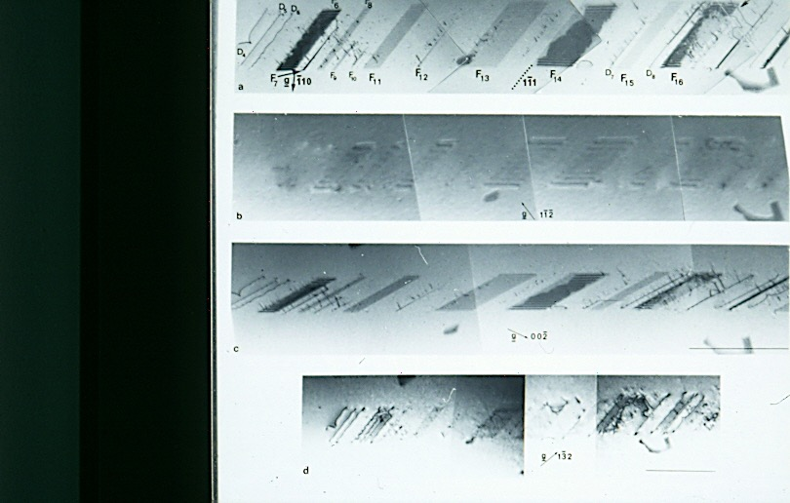

Slide 11
Case II
Habit Plane of F₆, F₇... F₁₆ (121)
Displacement Vector of Various Faults
Fault contrast is visible for $\vec{g}$ = $\overline{1}$10 and 00$\overline{2}$ and
invisible for $\vec{g}$= 1$\overline{1}\overline{2}$ and 1$\overline{3}$2 and only the partials bounding
F₆, F₇, F₁₄ and F₁₆ are visible for $\vec{g}$= 1$\overline{3}$2 ;
It is concluded that the displacement vector is ± 1/6[1$\overline{1}$1].
Burgers vector of Dislocations D₄, D₅...D₉
In contrast for $\vec{g}$= $\overline{1}$10, 00$\overline{2}$ and 1$\overline{3}$2
Invisible for $\vec{g}$= 1$\overline{1}\overline{2}$
Therefore, the Burgers vector is ± ½[1$\overline{1}$1]
Conclusion
The Burgers vector of fault partials is parallel to that of the glide dislocations.
½[1$\overline{1}$1]_{screws} → 3 x 1/6[1$\overline{1}$1]

Slide 12
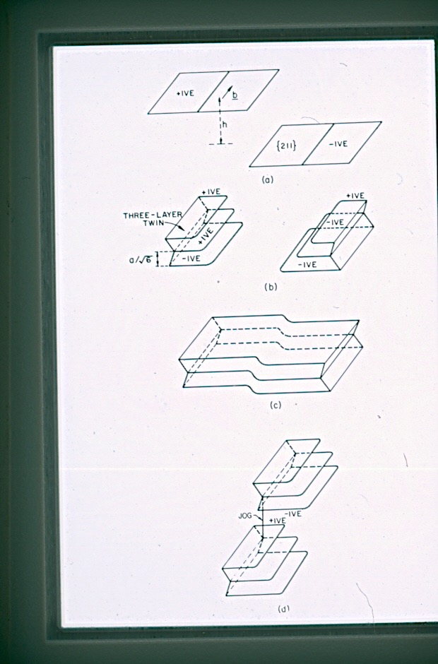
Formation of ‘Clear’ Faults

Slide 13
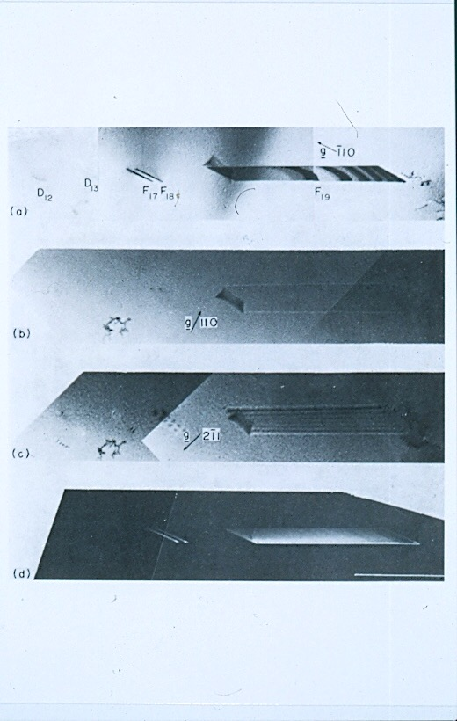

Slide 14
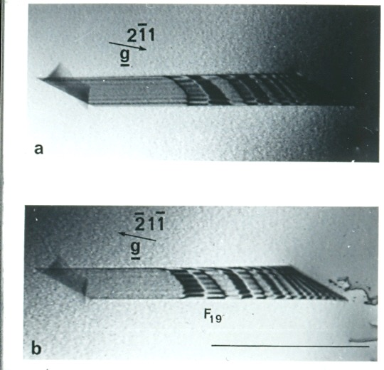

Slide 15
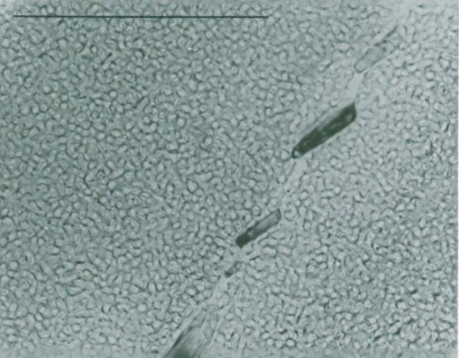
Spinodal Decomposition in Fe-Cr-Co Alloy
Grain Boundary
Precipitates

Slide 16
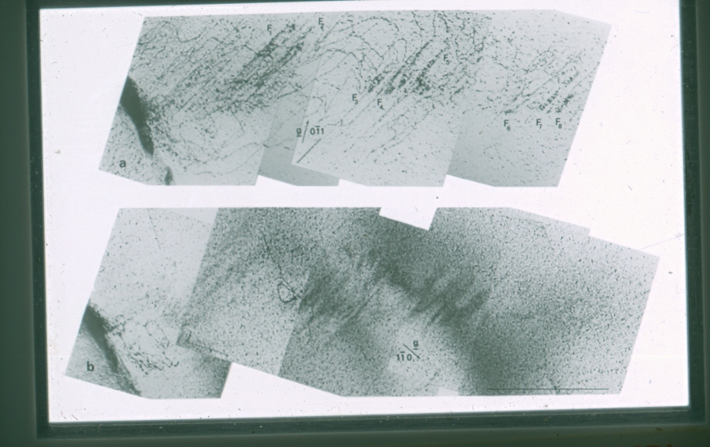

Slide 17
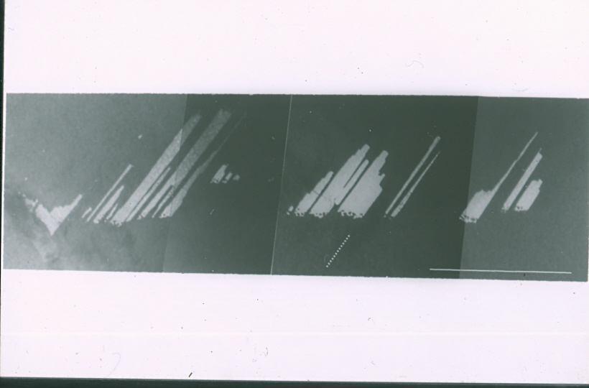

Slide 18
Effects of Metallurgical Variables on Deformation Twinning in BCC Crystals

Slide 19
Metallurgical Variables
Critical resolved shear stress for twinning
Deformation temperature
Strain-rate
Alloying

Slide 20
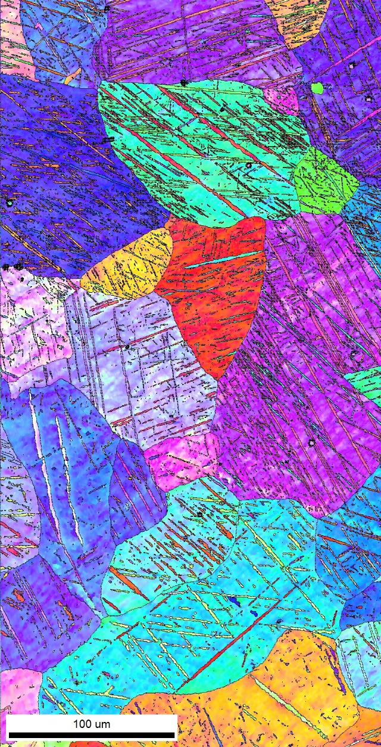
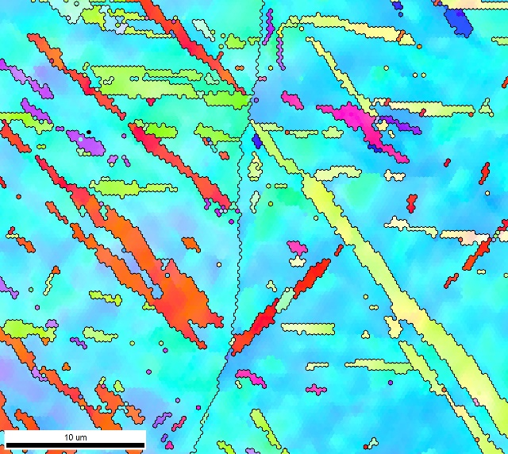
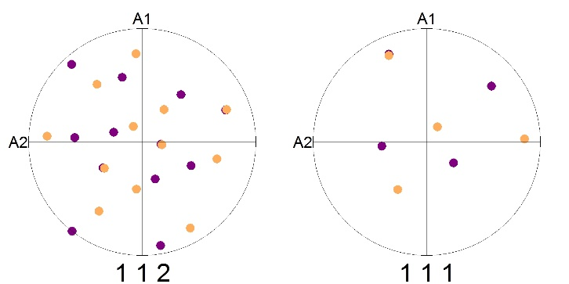
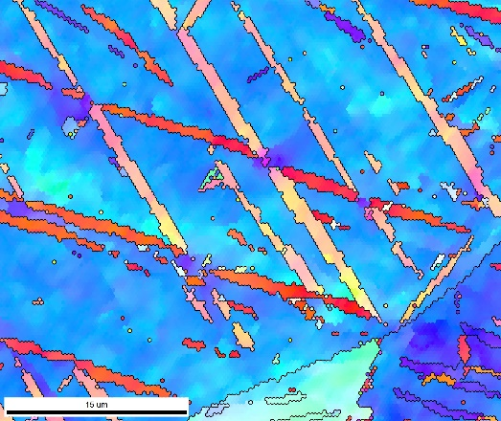
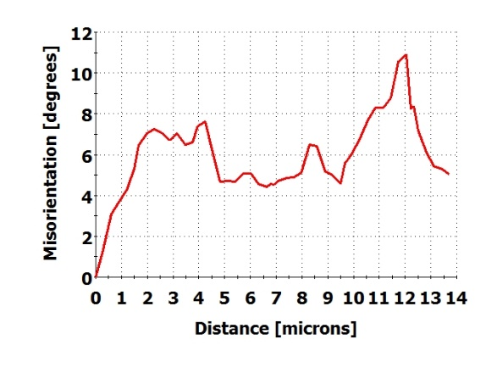
EBSD Study of Twins in Shock Loaded Iron
Crystal direction maps
Coincident
Ƞ1 directions
Coincident
K1 poles
Normal to
plane trace
Pole figures identifying {112}<111> twins
Multiple variants of the 60°@<111> twins
Orientation change along twins, indicating deformation
Misorientation along black arrow

Slide 21
Formation of Deformation Twins in FCC Crystals

Slide 22
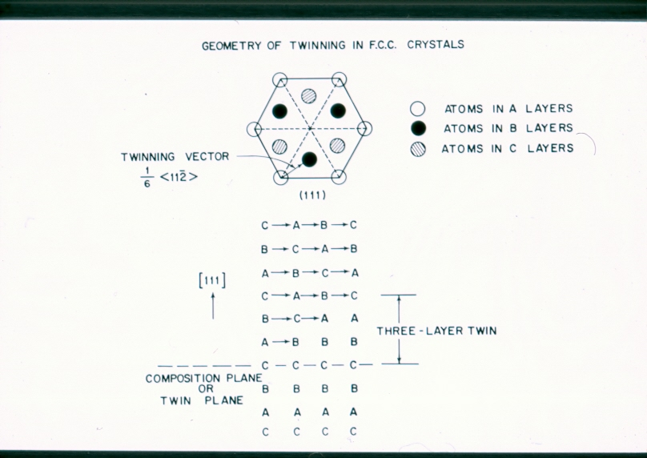

Slide 23
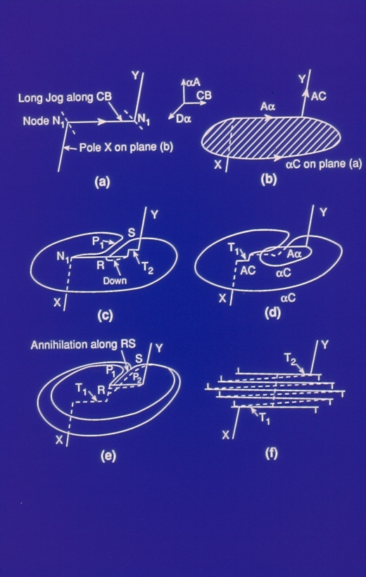
Pole Model (Venables)

Slide 24
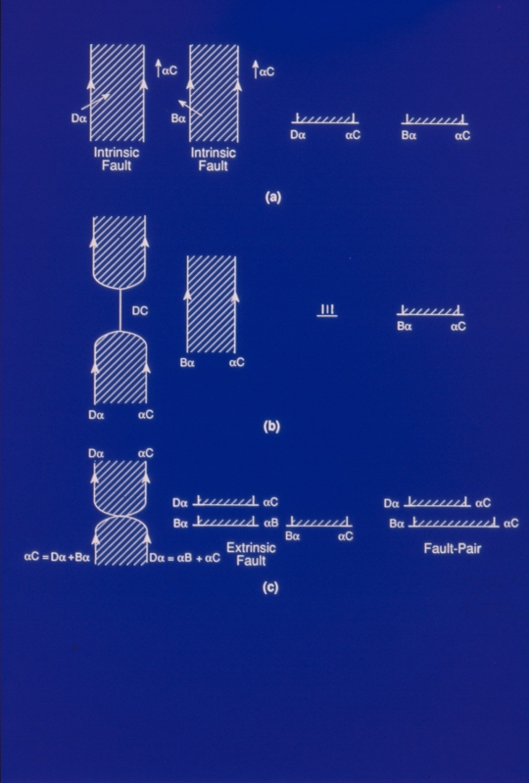
Formation of Fault Pairs

Slide 25
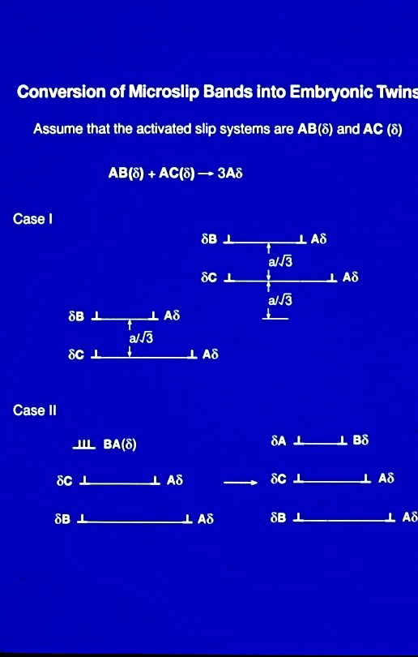

Slide 26
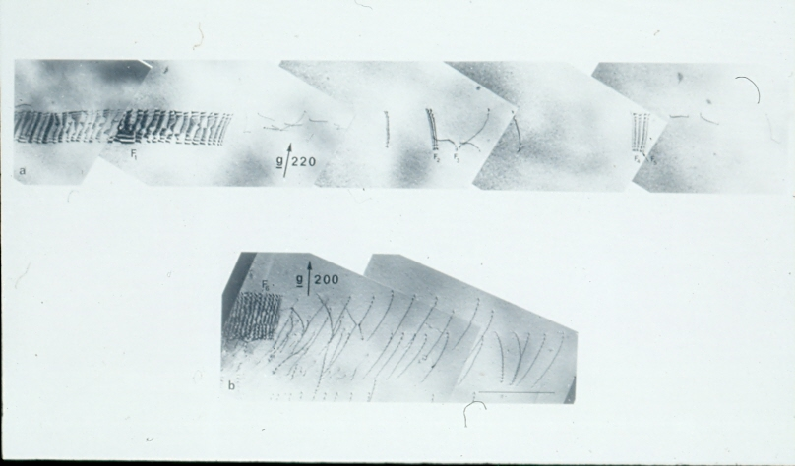

Slide 27
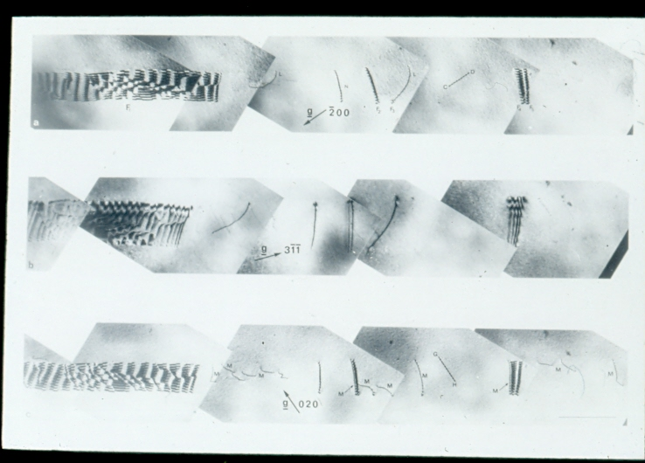

Slide 28
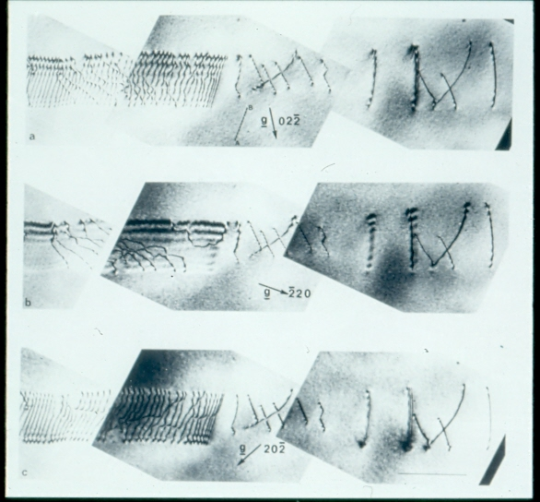

Slide 29
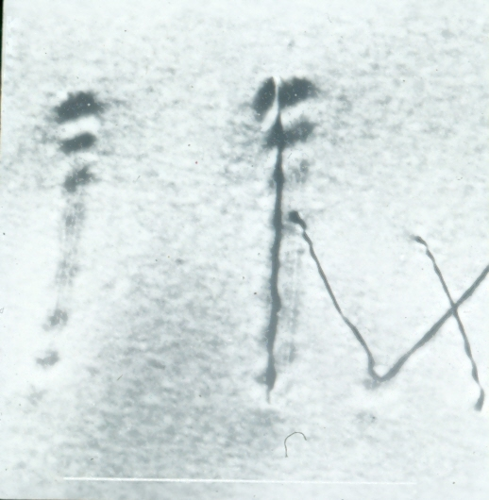

Slide 30
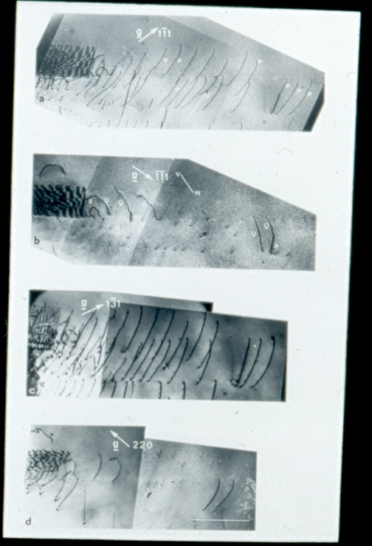

Slide 31
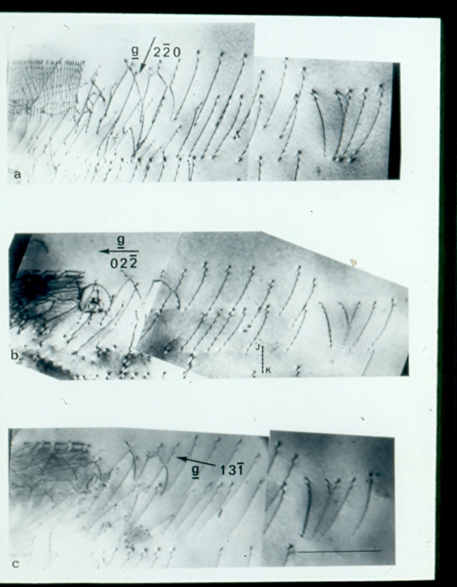

Slide 32
Orientation Dependence of FCC Twinning

Slide 33
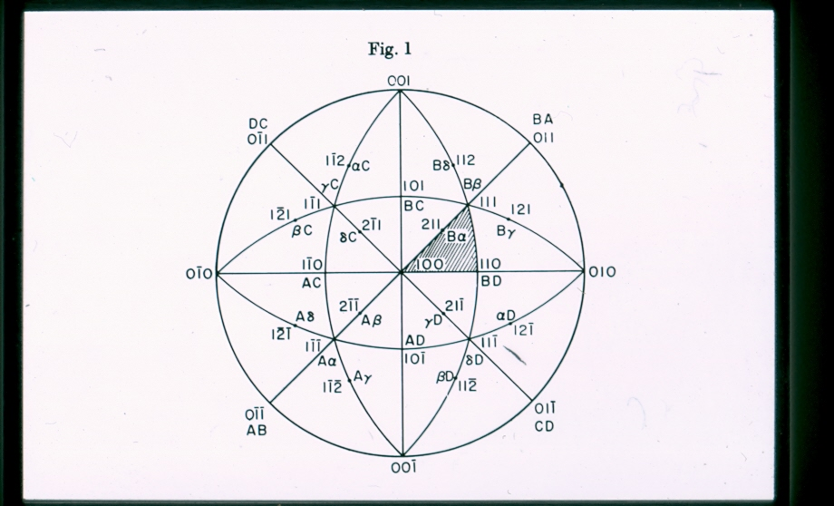

Slide 34
Formation of {11$\overline{2}$1} Twins in HCP Cobalt Single Crystals

Slide 35
Governing Reactions 2 x $\frac{1}{3}$ <$\overline{2}$11$\overline{3}$ > + <1$\overline{1}$00> → 12 x $\frac{1}{36}$ <$\overline{1}\overline{1}2\overline{6}>$ $\frac{1}{3 }$ [2$\overline{1}\overline{1}0]+$ $\frac{1}{3}$ [1$\overline{2}$10] → [1$\overline{1}$00]

Slide 36
Summary and Conclusions
Slip precedes deformation twinning in BCC, FCC and HCP structures
Embryonic twins evolve from dislocations
Microscopic twins form when stress-induced coalescence of embryonic twins occur that are located at different levels within micro-slip bands
Influence of metallurgical variables on deformation twinning can be rationalized in terms of the proposed models

